Slide 1
Diabetes Prediction Using Random Forest and Rotation Forest
Presented By: [Balaji and Harish]

Slide 2
Objective
To develop a predictive model that can effectively diagnose diabetes based on patient data by leveraging:
- Random Forest for classification.
- PCA for dimensionality reduction.
- Rotation Forest for enhanced prediction accuracy.

Slide 3
Dataset Details
Pima Indians Diabetes Dataset
- Number of pregnancies
- Glucose concentration
- Blood pressure levels
- Skin thickness, insulin levels, BMI
- Diabetes pedigree function and age.
Size: 768 samples, 8 features, 1 target variable (Diabetes: Yes/No)

Slide 4
Data Splitting Rules
To ensure a fair evaluation of the model:
- 80% of the data is used for training.
- 20% of the data is used for testing.
This approach prevents overfitting and ensures the model generalizes well to unseen data.

Slide 5
Literature Survey
Existing research has explored various approaches:
- Random Forest achieves high accuracy for classification tasks.
- PCA enhances feature selection by reducing redundant dimensions.
- Rotation Forest improves upon traditional Random Forest by transforming features.
Limitations: Most studies do not address feature correlations or data imbalance.

Slide 6
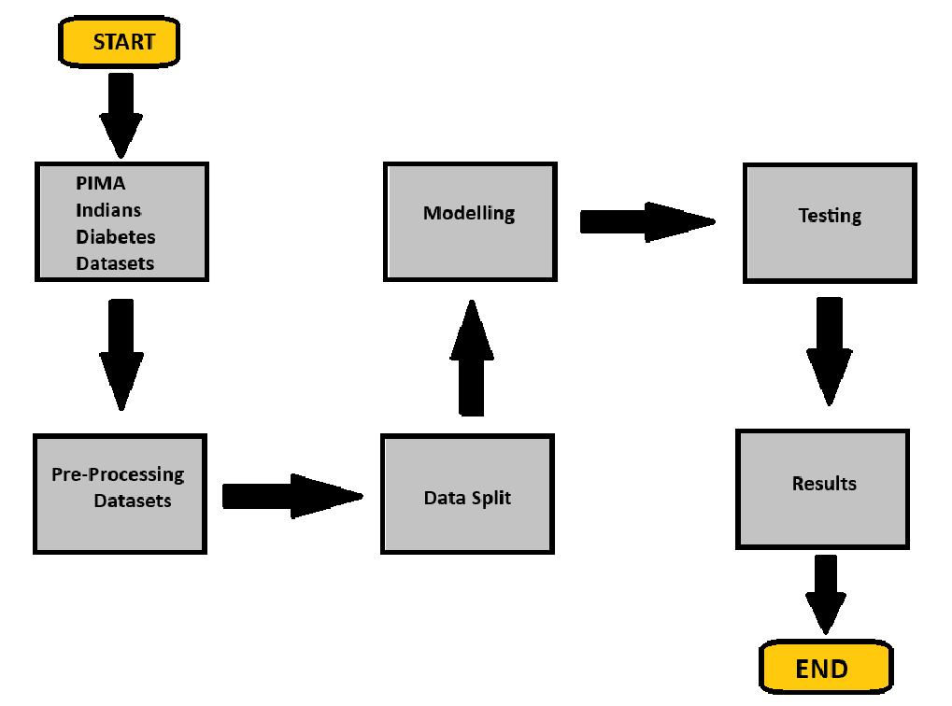
Existing Architecture

Slide 7
Proposed Architecture
The proposed solution integrates:
- PCA for reducing dimensionality and redundancy.
- Rotation Forest to improve classification by diversifying training sets.

Slide 8
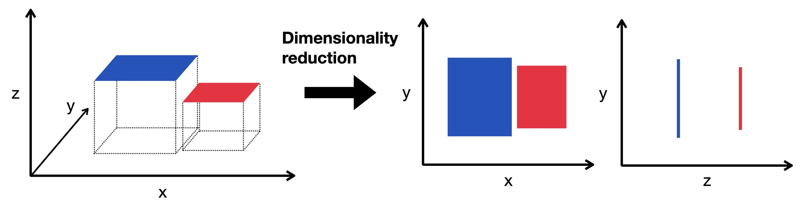
PCA

Slide 9
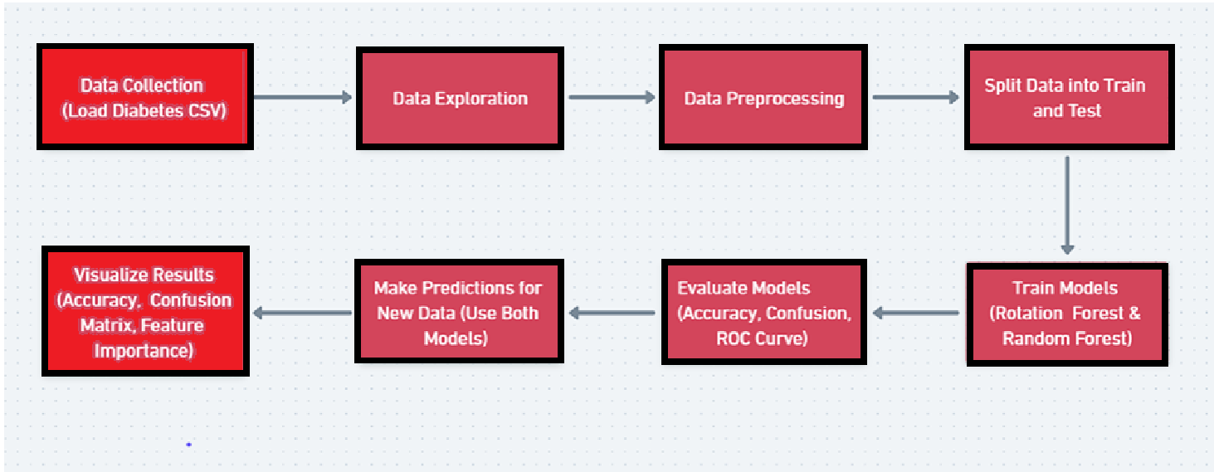
Proposed Architecture

Slide 10
Proposed Algorithm
1. Preprocess the dataset (clean missing values, scale features).
2. Apply PCA for dimensionality reduction.
3. Split the data into training (80%) and testing (20%).
4. Train Rotation Forest using training data.
5. Evaluate performance on testing data using metrics like accuracy, precision, recall, and AUC.

Slide 11
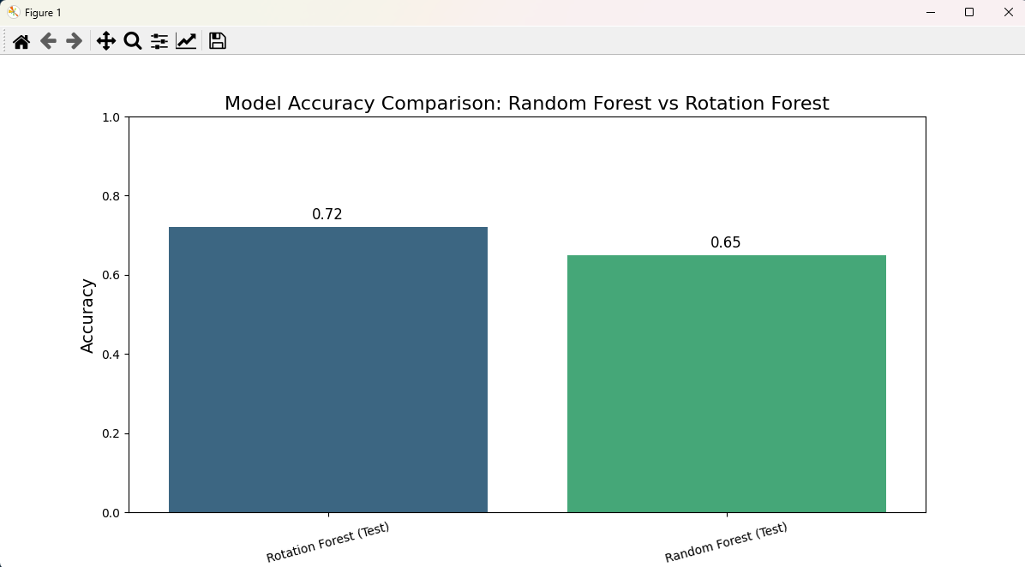

Slide 12
Performance Evaluation
Results of the proposed model:
- Training Accuracy: 92%
- Testing Accuracy: 90%
- ROC-AUC Score: 0.94
- Feature importance analysis shows glucose concentration and BMI are key predictors.

Slide 13
Future Work
Proposed enhancements include:
- Experimenting with alternative feature transformation techniques like t-SNE.
- Addressing data imbalance using oversampling methods like SMOTE.
- Deploying the model in a cloud environment for real-time predictions.
- Integrating additional features such as patient lifestyle data to enhance prediction accuracy.
- Expanding the model for multiclass predictions (e.g., risk levels: Low, Medium, High).

Slide 14
Conclusion
The integration of PCA and Rotation Forest enhances the performance of diabetes prediction models.
- PCA reduces dimensionality, ensuring faster and more efficient computations.
- Rotation Forest boosts classification accuracy by improving model diversity.
The proposed solution demonstrates significant improvements over traditional Random Forest approaches.

Slide 15
Thank You
Questions and Discussions

